Slide 1
RoboCat- Sprint 2
ALEX VILD, QUINTIN FETTES, ZACH TAYLOR, KURTIS DAVIS, SEATTLE RUZEK, LUKE SHAYS

Slide 2
What’s New?
No requirement changes
Continued development of features that were requested last sprint
App is uploaded to play store

Slide 3
Individual Contributions: Milestone 2
Speech Recognition Team:
Alex:
Slight modifications to Pocketsphinx code
New menu command navigation, higher threshold, more command words
Fixed security vulnerabilities and uploaded app to play store
Improved readme and pocketsphinx documentation
Kurtis:
Took out repetitive command and added new command for the cat to step forward
Notes:
Present

Slide 4
Individual Contributions: Milestone 2
Facial Recognition Team:
Quintin
Removed dead code and scripts
most of it related to opencv
Added groundwork for multiface tracking
code exists to allow for multiple faces to be tracked in behavior mode, not fully implemented
Added groundwork for a side-by-side view of behavior mode and a camera preview
primarily for verification purposes. It provides the user an option to see what the cat is see while also observing what the gui is doing. Not fully implemented
Notes:
Present

Slide 5
Individual Contributions: Milestone 2
Facial Recognition Team:
Lukas
Added rough implementation of color tracking to Robocat
Has yet to be tested with the cat itself
Only looks for red at the moment
Added button on Robocat UI to switch modes between face tracking and color tracking.
Notes:
Present

Slide 6
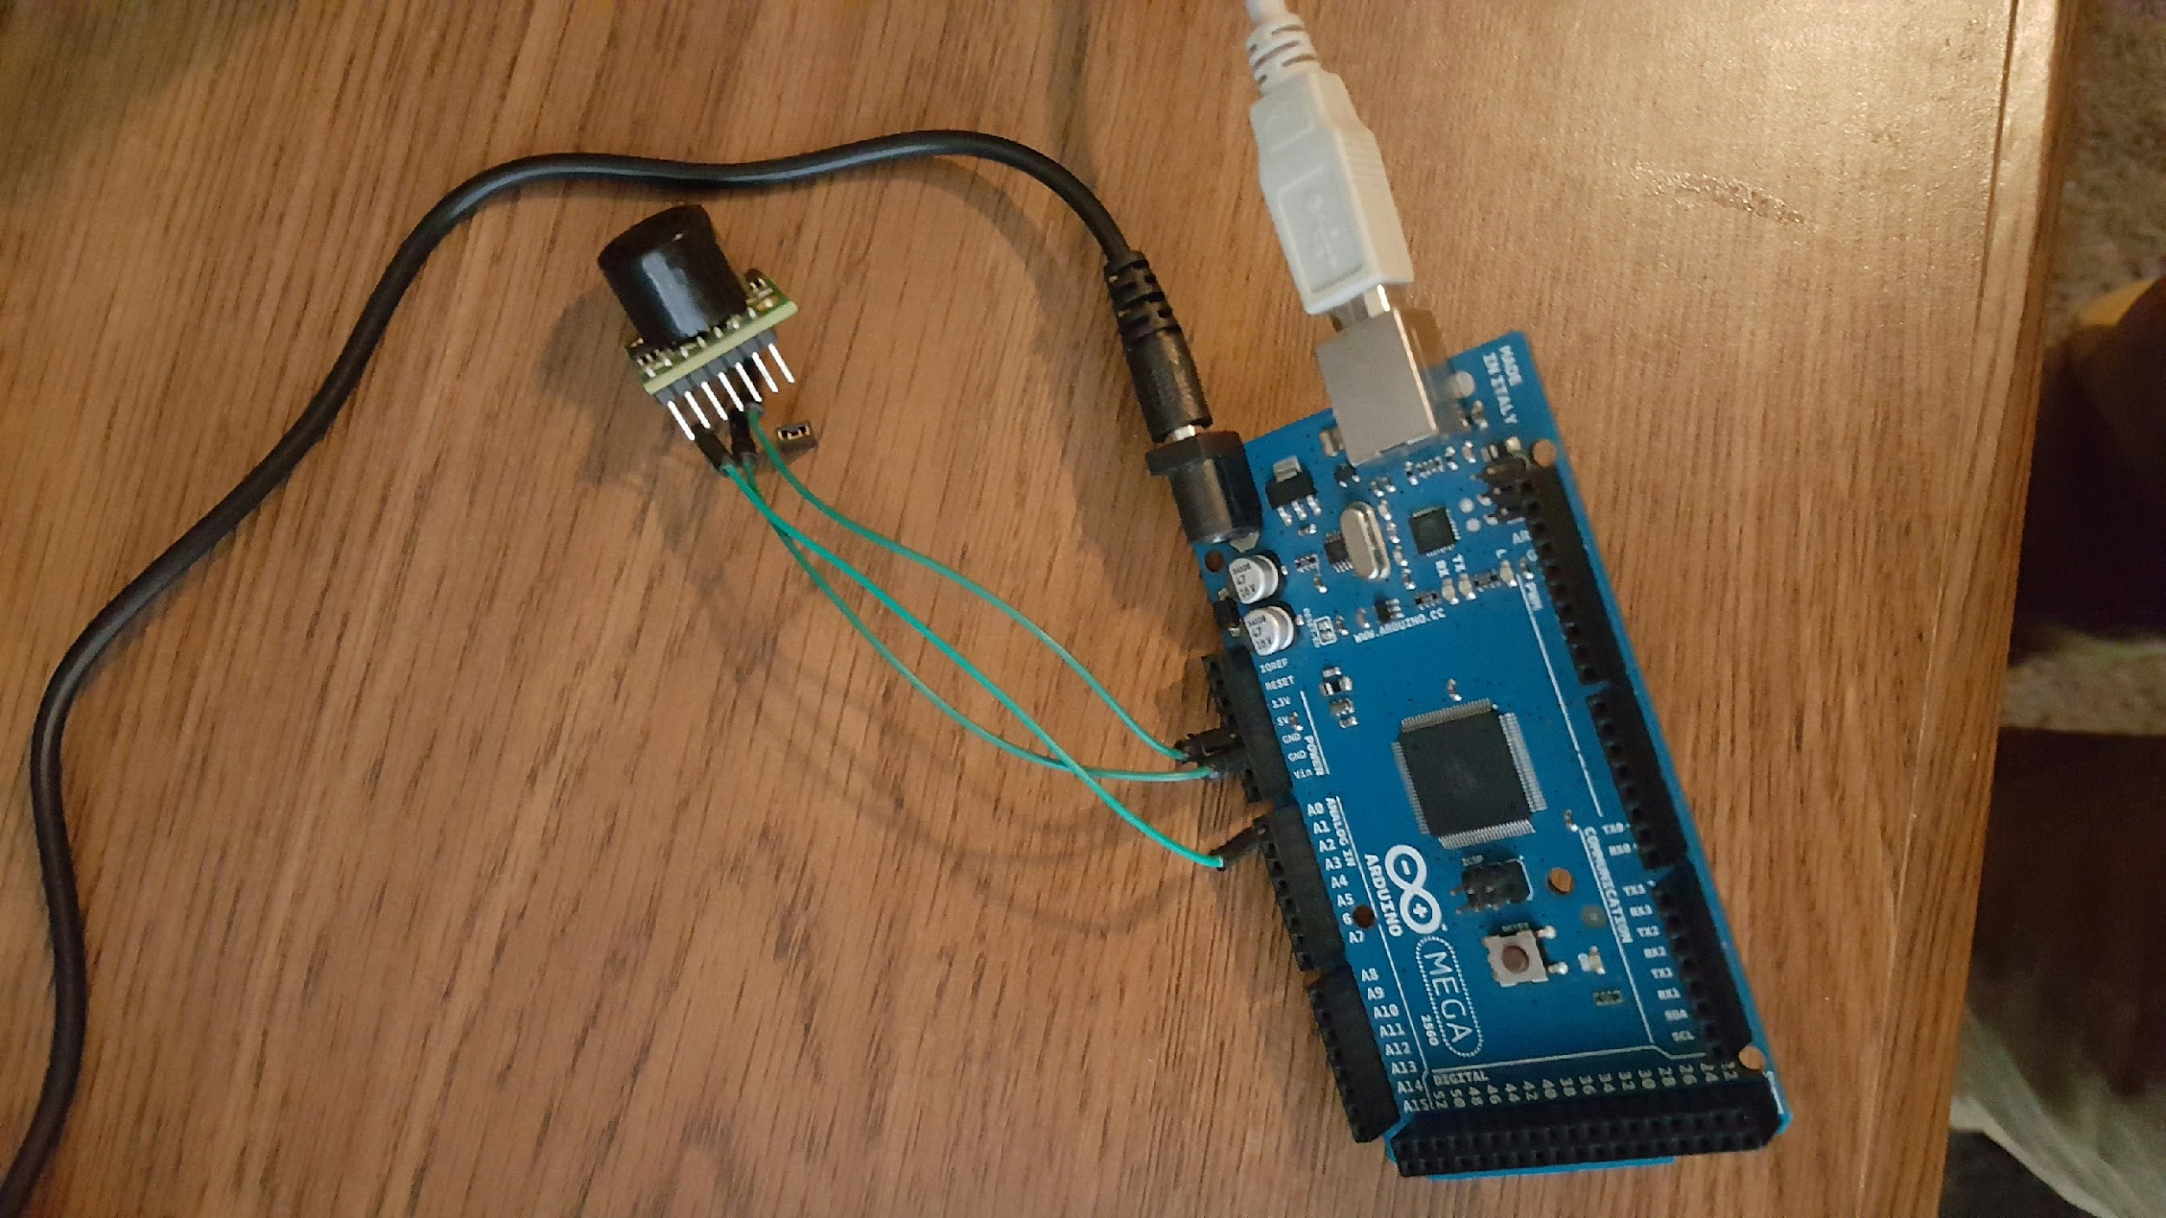
Individual Contributions: Milestone 2
Environmental Mapping Team:
Physically connected the arduino to the ultrasonic sensor via 3 connection wires
Seattle:
Wrote and tested code for arduino and android connection
Zach
Wrote and tested code for sonic sensor and arduino
Battery debugging
Notes:
Present

Slide 7
Milestone 3 Goals
Facial Recognition Team:
Lukas
Test color tracking on the cat itself and work out bugs.
Give user ability to specify what color to track for.
Make color tracking UI more user friendly.
Quintin
Full implementation of multi-face tracking
the cat will turn to look at the happiest face
Full implementation of camera preview/behavior mode side-by-side mode
Notes:
Present

Slide 8
Milestone 3 Goals
Speech Recognition
Alex
Continue to research noise gate possibilities and accuracy options for pocketsphinx
Assist in other aspects of the app as they come up
Kurtis
Continue to research different ways to get the cats legs to move
Tweak different commands already implemented for moving the cats legs.

Slide 9
Milestone 3 Goals
Environmental Mapping Team
Zach
Integrate sonic sensor data into main app
Pass commands to servo controller through Arduino
Seattle
Implement the code by connecting the Arduino board to the Robocat.
Test communication between Arduino (and sonic sensor) to the Android.

Slide 10
Long Term Goals
Continuous Voice Recognition for existing commands
Add Commands that control the servos motor
More robust commands:
switch tracking modes
Better performance
Vision
Face Tracking
Emotion Detection - Done
Track face with the highest happiness value
Happiness value of tracked affects the GUI of the app - done
Long term: cat “remembers” happy people and prefers them
side-by-side camera preview/behavior mode view
Color Tracking
effective background color tracking, enable via menu or voice commands
Notes:
Present

Slide 11
Long Term Goals
Environmental mapping: functioning sensor and mapping. The cat can’t walk, so functionality will be slightly limited
Install Arduino and ultrasonic sensor
Gather data of environment around RoboCat
Create map of area around cat using distances of objects returned by sensor
Battery indicator
Face and behavior change depending on battery level

